Slide 1
Facade Design Pattern
The Facade pattern provides a convenient higher-level interface to a larger body of code, hiding its true underlying complexity.
Facades are a structural pattern that can often be seen in JavaScript libraries like jQuery where, although an implementation may support methods with a wide range of behaviors, only a "facade" or limited abstraction of these methods is presented to the public for use.
@ShankaragoudaG

Slide 2
Facade Design Pattern
jQuery's $(el).css() or $(el).animate() methods, we're actually using a Facade - the simpler public interface that avoids us having to manually call the many internal methods in jQuery core required to get some behavior working. This also avoids the need to manually interact with DOM APIs and maintain state variables.
Facade pattern both simplifies the interface of a class and it also decouples the class from the code that utilizes it.

Slide 3
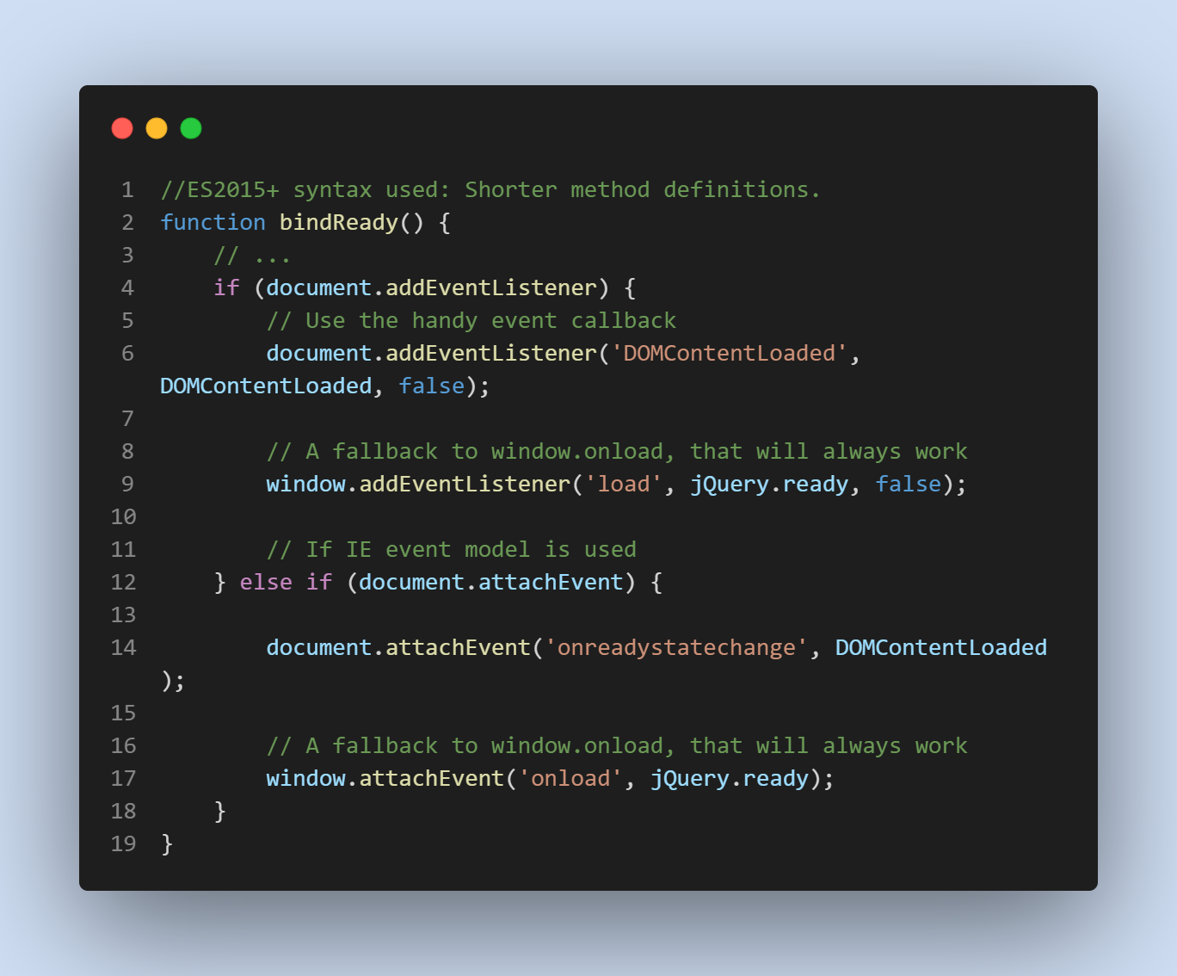
Facade Pattern Example
jQuery's $(document).ready(..). Internally, this is actually being powered by a method called bindReady(), which is doing this:

Slide 4
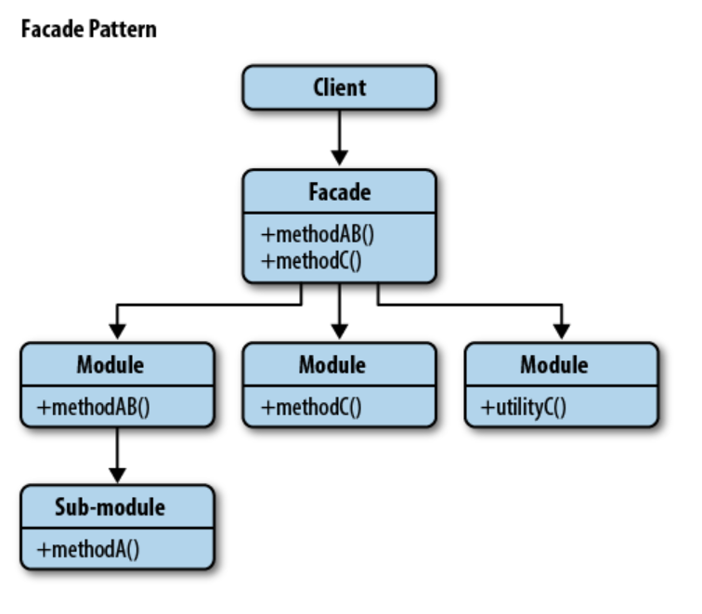
Facade Pattern Diagram

Slide 5
When To Use
There is a complex system and you need a simple interface to communicate with it.
The code is tightly coupled due to the client needing a wide knowledge of the system. The Facade pattern allows us to reduce the coupling between components.
The system need an entry point to each level of layered software.

Slide 6
advantages
The code is easier to use, understand, and test since the facade simplifies the interface.
Clean code because the client/context does not use a complex interface and the system is more flexible and reusable.

Slide 7
Useful Resources
https://www.patterns.dev/posts/classic-design-patterns/#facadepatternjavascript
https://www.dofactory.com/javascript/design-patterns/facade
https://www.oreilly.com/library/view/learning-javascript-design/9781449334840/ch09s09.html
https://dev.to/tomekbuszewski/facade-pattern-in-javascript-3on4

